Slide 1
Decision Tree

Slide 2
Decision tree is the most powerful and popular tool for classification and prediction.
A Decision tree is a flowchart like tree structure, where each internal node denotes a test on an attribute, each branch represents an outcome of the test, and each leaf node (terminal node) holds a class label.

Slide 3


Slide 4
Decision Trees usually mimic human thinking ability while making a decision, so it is easy to understand.
The logic behind the decision tree can be easily understood because it shows a tree-like structure.

Slide 5
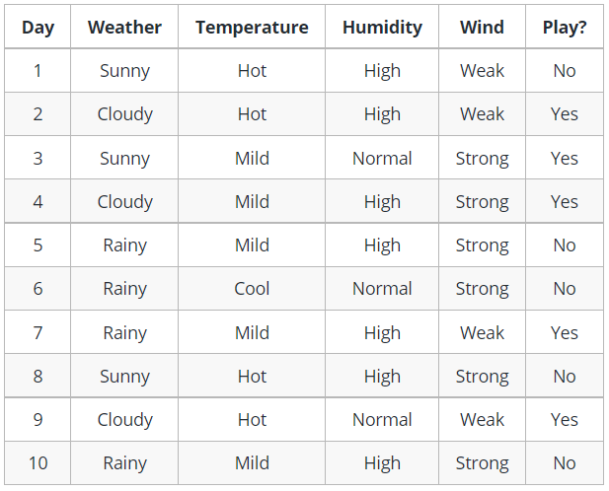

Slide 6
